Slide 1

RV College of Engineering
Advances in Operating System
Unit 3:
Process Descriptor
Aishwarya B
Department of CSE
RV College Of Engineering

Slide 2
RV College of Engineering
Relationships Among Processes
How Processes Are Organized
Process Resource Limits

Slide 3
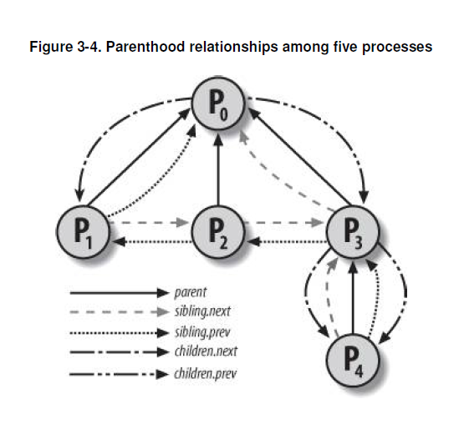
Relationships Among Processes
When a process creates multiple children , these children have sibling relationships. Several fields must be introduced in a process descriptor to represent these relationships.
Parenthood relationships
real_parent : Points to the process descriptor of the process that created P or to the descriptor of process 1 (init) if the parent process no longer exists.
Parent : Points to the current parent of P ; its value usually coincides with that of real_parent.
Children : The head of the list containing all children created by P.
Sibling : The pointers to the next and previous elements in the list of the sibling processes, those that have the same parent as P.

Slide 4
Relationships Among Processes
Non-parenthood relationships
group_leader : Process descriptor pointer of the group leader of P
signal->pgrp : PID of the group leader of P
Tgid : PID of the thread group leader of P
signal->session : PID of the login session leader of P
ptrace_children : The head of a list containing all children of P being traced by a debugger
ptrace_list :The pointers to the next and previous elements in the real parent's list of traced processes (used when P is being traced)

Slide 5
Relationships Among Processes
In several circumstances, the kernel must be able to derive the process descriptor pointer corresponding to a PID.
Scanning the process list sequentially and checking the pid fields of the process descriptors is feasible but rather inefficient. To speed up the search, four hash tables have been introduced. Why multiple hash tables?
Simply because the process descriptor includes fields that represent different types of PID and each type of PID requires its own hash table.
Hash table type -- Field name -- Description
PIDTYPE_PID -- pid -- PID of the process
PIDTYPE_PGID – pgrp -- PID of the group leader process
PIDTYPE_TGID – tgid -- PID of thread group leader process
PIDTYPE_SID – session -- PID of the session leader process
The four hash tables are dynamically allocated during the kernel initialization phase, and their addresses are stored in the pid_hash array. The size of a single hash table depends on the amount of available RAM.
Hash function does not always ensure a one-to-one correspondence between PIDs and table indexes. Two different PIDs that hash into the same table index are said to be colliding.
Linux uses chaining to handle colliding PIDs; each table entry is the head of a doubly linked list of colliding process descriptors.

Slide 6
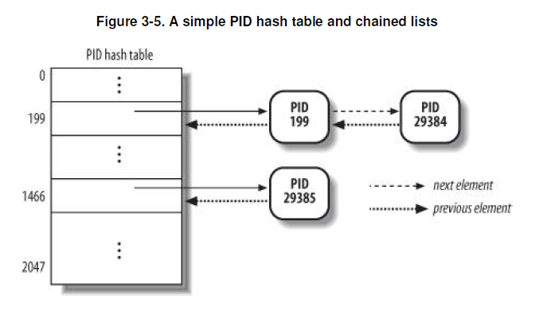
Relationships Among Processes
The hash tables are dynamically allocated during the kernel initialization phase, and their addresses are stored in the pid_hash array. The size of a single hash table depends on the amount of available RAM.
Hash function does not always ensure a one-to-one correspondence between PIDs and table indexes. Two different PIDs that hash into the same table index are said to be colliding.
Linux uses chaining to handle colliding PIDs; each table entry is the head of a doubly linked list of colliding process descriptors.

Slide 7
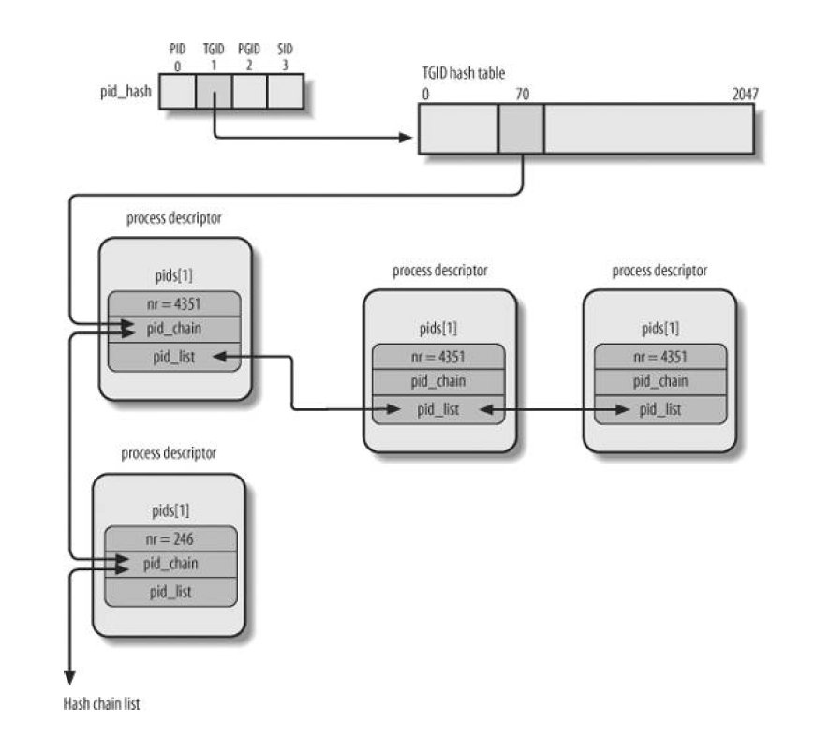
Relationships Among Processes
As an example, suppose that the kernel must retrieve all processes belonging to a given thread group, that is, all processes whose tgid field is equal to a given number.
Looking in the hash table for the given thread group number returns just one process descriptor, that is, the descriptor of the thread group leader. To quickly retrieve the other processes in the group, the kernel must maintain a list of processes for each thread group.
The PID hash tables' data structure is an array of four pid structures embedded in the pids field of the process descriptor.
Type – Name – Description – PID number

Slide 8
How Processes Are Organized
Processes in a TASK_STOPPED, EXIT_ZOMBIE, or EXIT_DEAD state are not linked in specific lists. There is no need to group processes in any of these three states, because stopped, zombie, and dead processes are accessed only via PID or via linked lists of the child processes for a particular parent.
Processes in a TASK_INTERRUPTIBLE or TASK_UNINTERRUPTIBLE state are subdivided into many classes, each of which corresponds to a specific event. In this case, the process state does not provide enough information to retrieve the process quickly, so it is necessary to introduce additional lists of processes. These are called wait queues.
Wait queues implement conditional waits on events: a process wishing to wait for a specific event places itself in the proper wait queue and relinquishes control. Therefore, a wait queue represents a set of sleeping processes, which are woken up by the kernel when some condition becomes true.
Wait queues are implemented as doubly linked lists whose elements include pointers to process descriptors. Each wait queue is identified by a wait queue head. Synchronization is achieved by the lock spin lock in the wait queue head.
Each element in the wait queue list represents a sleeping process, which is waiting for some event to occur; its descriptor address is stored in the task field. The task_list field contains the pointers that link this element to the list of processes waiting for the same event.
There are two kinds of sleeping processes: exclusive processes (denoted by the value 1 in the flags field of the corresponding wait queue element) are selectively woken up by the kernel, while nonexclusive processes (denoted by the value 0 in the flags field) are always woken up by the kernel when the event occurs.

Slide 9
How Processes Are Organized
Handling wait queues :
DECLARE_WAIT_QUEUE_HEAD(name)
init_waitqueue_head( )
init_waitqueue_entry(q,p ){
q->flags = 0;
q->task = p;
q->func = default_wake_function;}
DEFINE_WAIT()
add_wait_queue( )
add_wait_queue_exclusive( )
remove_wait_queue( )
waitqueue_active( )
sleep_on( )-
void sleep_on(wait_queue_head_t *wq){
wait_queue_t wait;
init_waitqueue_entry(&wait, current);
current->state = TASK_UNINTERRUPTIBLE;
add_wait_queue(wq,&wait); /* wq points to the wait queue head */
schedule( );
remove_wait_queue(wq, &wait);}

Slide 10
How Processes Are Organized
Handling wait queues :
interruptible_sleep_on( )
sleep_on_timeout( )
interruptible_sleep_on_timeout( )
wait_event and wait_event_interruptible macros put the calling process to sleep on a wait queue until a given condition is verified.
DEFINE_WAIT(_ _wait);
for (;;) {
prepare_to_wait(&wq, &_ _wait, TASK_UNINTERRUPTIBLE);
if (condition)
break;
schedule( );
}
finish_wait(&wq, &_ _wait);

Slide 11
Process Resource Limits
Each process has an associated set of resource limits , which specify the amount of system resources it can use. These limits keep a user from overwhelming the system (its CPU, disk space, and so on). Linux recognizes the following resource limits.
The resource limits for the current process are stored in the current->signal->rlim field.
struct rlimit {
unsigned long rlim_cur;
unsigned long rlim_max;
};
RLIMIT_AS - maximum size of process address space, in bytes
RLIMIT_CPU - The maximum CPU time for the process, in seconds
RLIMIT_DATA - The maximum heap size, in bytes
RLIMIT_CORE - The maximum core dump file size, in bytes
RLIMIT_FSIZE - The maximum file size allowed, in bytes
RLIMIT_LOCKS - Maximum number of file locks
RLIMIT_NPROC - The maximum number of processes that the user can own
RLIMIT_SIGPENDING – The maximum number of pending signals for the process
RLIMIT_STACK - The maximum stack size, in bytes
RLIMIT_RSS - The maximum number of page frames owned by the process

Slide 12
Thank You

